Slide 1

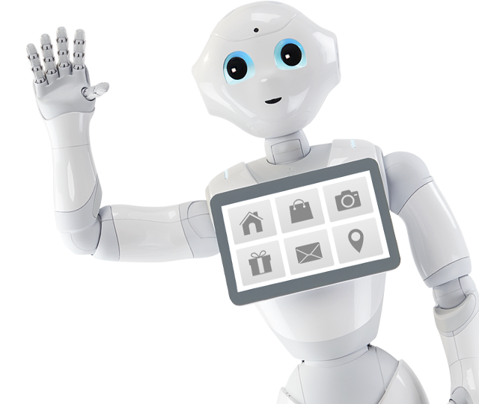
Università degli studi di Salerno
Dipartimento di Ingegneria dell’Informazione ed Elettrica e Matematica Applicata
Corso di Laurea Magistrale in Ingegneria Informatica
Cognitive Robotics Midterm Project
Team:
Giovanni Ammendola
Edoardo Maffucci
Vincenzo Petrone
Salvatore Scala

Slide 2
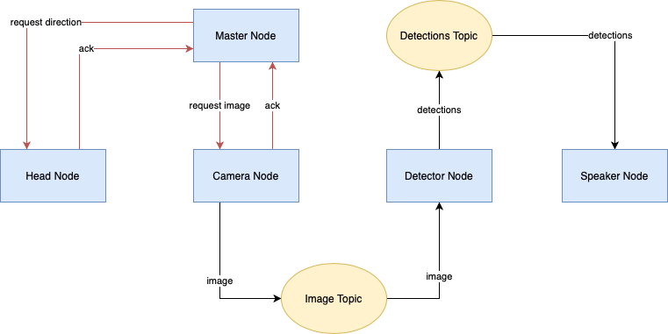
Architecture
Coordinates Head and Camera nodes.
Calls LookAt and TakePicture services successively.
LookAt is used to request to move the head in a desired position: left, front or right.
TakePicture is called when the position is reached to take a picture.
Communication mechanisms:
Topics.
Services: to receive an ack when the job is completed.

Slide 3
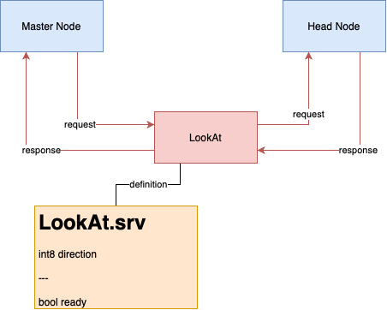
Head Node
This node represents the server for the LookAt service.
Moves the head in the desired position using ALMotion proxy.

Slide 4
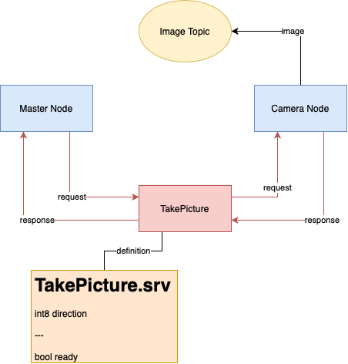
Camera Node
This node represents the server for the TakePicture service.
Starts the acquisition of images from the robot’s camera using the ALVideoDevice proxy.
Publishes the images on ImageWithDirection topic.

Slide 5
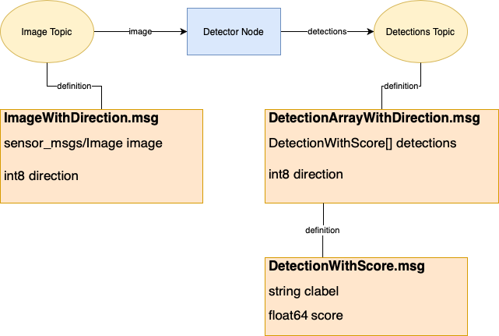
Detector Node
This node detects objects in images.
Once it receives an image from the topic, runs inference in it.
Model: EfficientDetD1, it provides a right trade-off between accuracy and time performances.
Publish the detected objects on Detections topic.

Slide 6
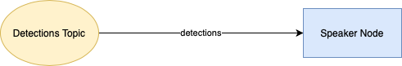
Speaker Node
This node makes the robot speak.
Subscriber of Detections topic.
Upon receiving a new message on the topic, it stores a part of the sentence to say.
When all three messages are received, it uses ALAnimatedSpeech proxy to make the robot speak and move.

Slide 7
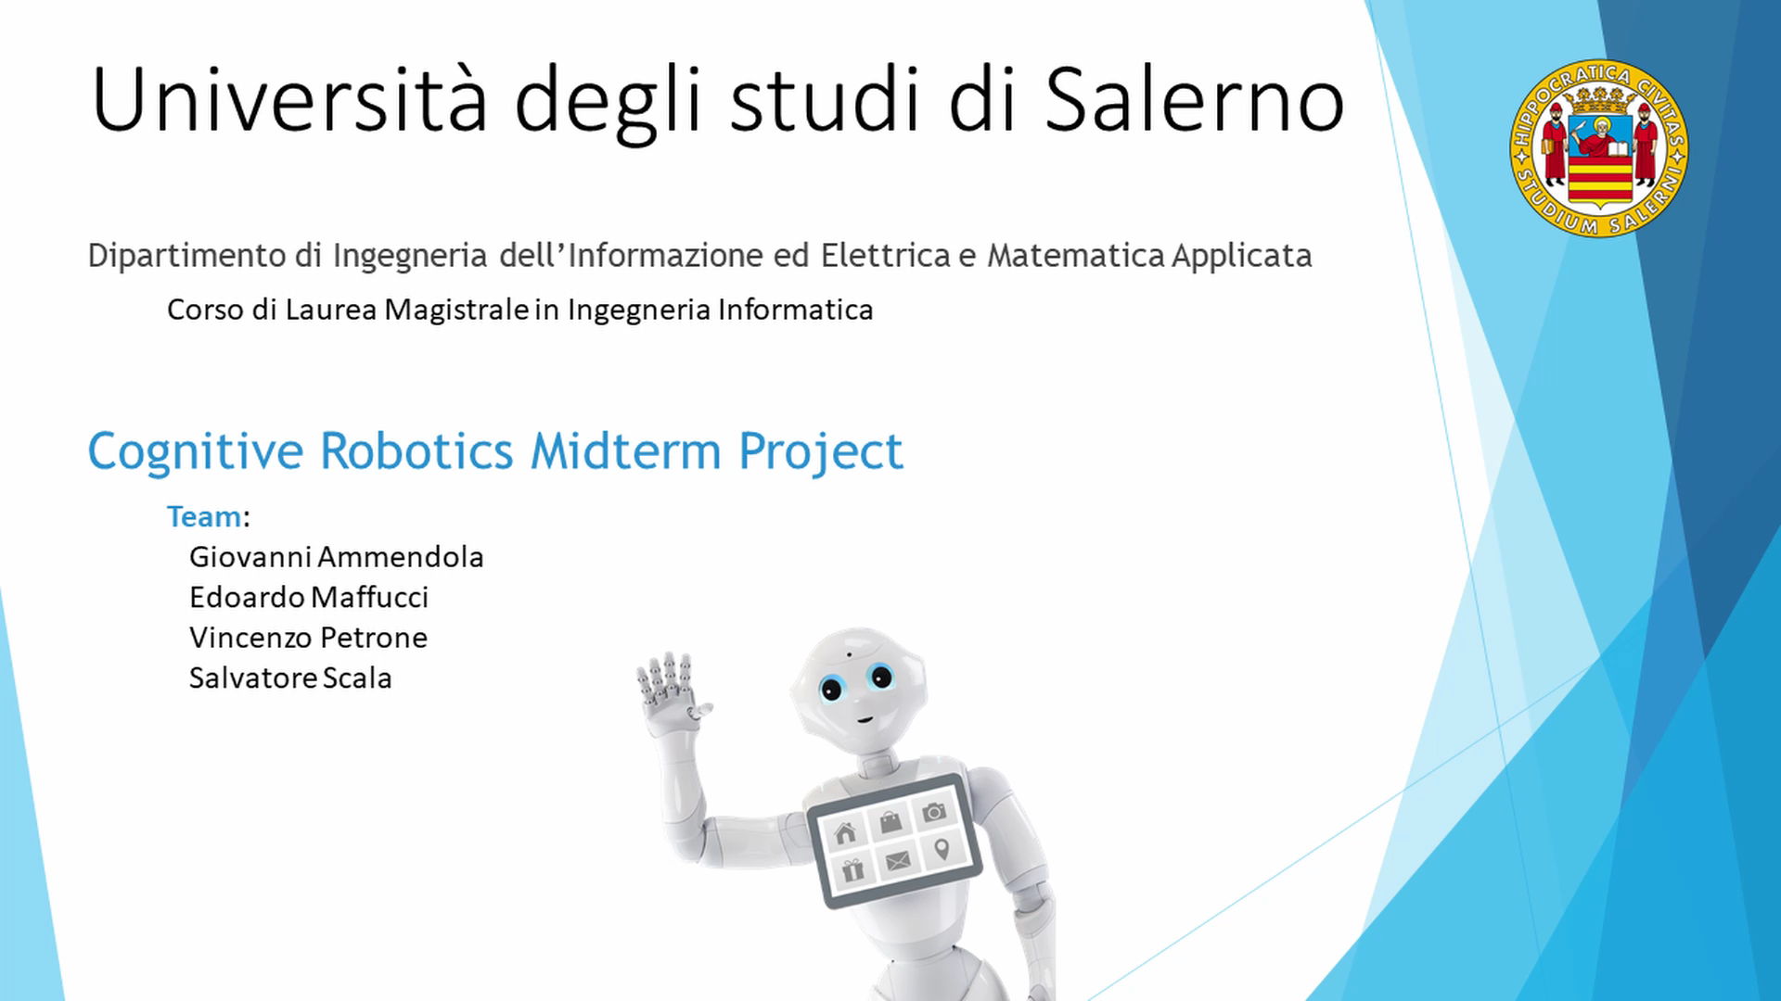
Demo Video

